Slide 1

Apache Hbase, MongoDB, S3

Slide 2
Types of Databases
Distributed Database – Hbase, HDFS
Relational Database – MySQL, Oracle
Cloud Database – AWS S3
Object Oriented Database
Centralized Database
Personal Database
NoSQL Database – MongoDB, Hbase, Cassandra, Neo4j

Slide 3
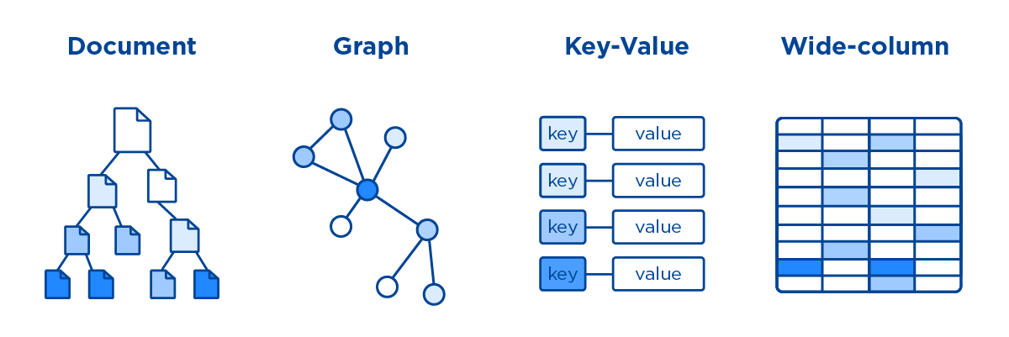
Types of NoSQL
MongoDB
CouchDB
neo4j
AWS S3
HBase
Cassandra
Fig. Types of NoSQL Database

Slide 4
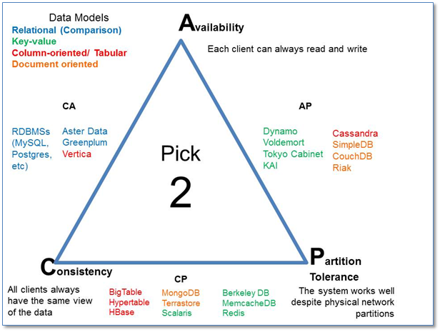
CAP Theorem

Slide 5
Examples
Blog Website – A
Multiplayer online games – A
Stock trading platforms – C
Video Streaming websites – A
Ticket Booking system – C
Video Chat Application – A
Bank – C
A = Availability
C = Consistency

Slide 6
SQL vs NoSQL
SQL | NoSQL
Relational Database | Non Relational Database
Fixed Schema design and structure | Dynamic Schema design and structure
Handles complex queries | Handles Simple Queries
Vertically Scalable | Horizontally Scalable – add no. of nodes
Follows ACID property | Follows CAP property

Slide 7
Introduction- HBase
Apache HBase is an open-source, NoSQL, column-oriented, random read/write access, distributed big data store.
HBase integrates seamlessly with Apache Hadoop ecosystem and runs on top of the Hadoop Distributed File System (HDFS) or Amazon S3 using Amazon Elastic MapReduce (EMR) file system or EMRFS.
HBase serves as a direct input and output to the Apache MapReduce framework for Hadoop and works with Apache Phoenix to enable SQL-like queries over HBase tables.

Slide 8
Why do we need?
There are number of limitations in RDBMS are as follows:
Not preferable for unstructured data.
Works very well for a limited number of records
Doesn’t contain de-normalized data.
Schema-oriented database.

Slide 9
Features
Linearly Scalable
Schema-less
Fast due to random access
Fault Tolerant - Automatic failure support
Column Oriented
Low latency access for data
Applications
FINRA - Financial Industry Regulatory Authority
MONSTER

Slide 10
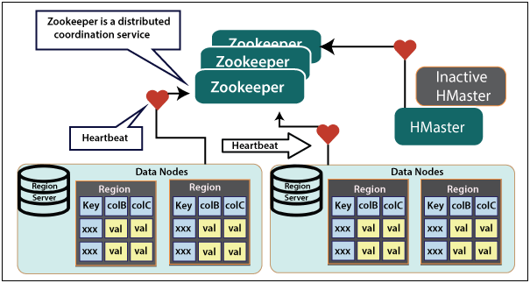
Architecture of HBase
Fig. HBASE Architecture

Slide 11
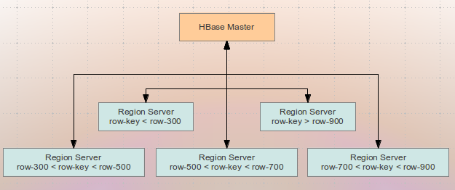
Contd…
Fig. Abstract view of HBase Architecture

Slide 12
Contd…
Master Server
Handles load balancing of the regions across region servers
Maintains the state of the cluster by negotiating the load balancing.
Responsible for schema changes and other metadata operations such as creation of tables and column families.
Regions
Regions are like tables those are split up and spread across the region servers.

Slide 13
Contd…
Region Server
Communicate with the client and handle data-related operations.
Handle read and write requests for all the regions under it.
Decide the size of the region by following the region size thresholds.
ZooKeeper
Clients communicate with region servers via zookeeper.
Zookeeper has ephemeral nodes representing different region servers.
Master Servers use these nodes to discover available servers.
The nodes are also used to track server failures or network partitions

Slide 14
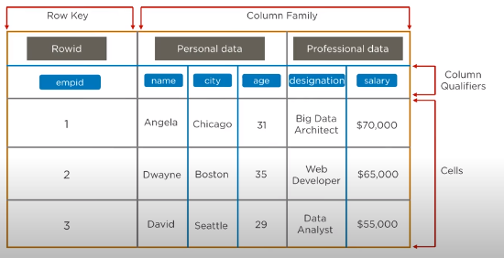
HBase Table Structure
Fig. HBase Table Structure

Slide 15
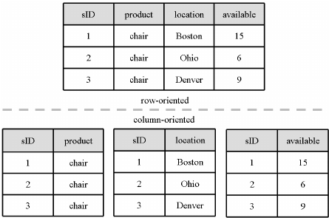
Contd…
Fig. Column Oriented vs. Row oriented Storage

Slide 16
HBase Commands
General Commands
1. STATUS - Provides the status of HBase, for example, the number of servers.
hbase(main)> status
3 servers, 0 dead, 1.3333 average load
2. VERSION - Provides the version of HBase being used.
hbase(main)> version
3. TABLE_HELP - Provides help for table-reference commands.
4. WHOAMI - Provides information about the user.

Slide 17
Contd….
CREATE TABLE
hbase> create 'emp', 'personal data', 'professional data‘
hbase > list
hbase> disable ‘emp’
hbase> scan ‘emp’
hbase> is_disabled ‘emp’ → true
hbase> enable ‘emp’
hbase> scan ‘emp’
1 column=personal data:city, timestamp=1417516501,value=hyderabad
hbase> describe ‘emp’
hbase> exists ‘emp’ → Table emp does exist

Slide 18
Contd…
hbase> disable 'emp'
0 row(s) in 1.4580 seconds
hbase> drop 'emp'
0 row(s) in 0.3060 seconds
hbase> drop_all 'e*'

Slide 19
Contd…
Using put command, you can insert rows into a table
hbase> put 'emp','1','personal data:name',’Raju‘
hbase> put 'emp','1','personal data:city',’Hyderabad‘
hbase> put 'emp','1','professional data:designation',’Mnager‘
hbase> put 'emp','1','professional data:salary','50000‘
hbase> put 'emp',‘row1','personal data:city',‘Delhi‘
ROW KEY | PERSONAL DATA |  | PROFESSIONAL DATA
empid | name | city | designation | salary
1 | Raju | Hyderabad | Manager | 50000

Slide 20
Contd…
The get command of HTable class is used to read data from a table in HBase.
hbase> get 'emp', '1'
personal : city timestamp = 1417521848375, value = Delhi personal : name timestamp = 1417521785385, value = Raju professional: designation timestamp = 1417521885277, value = Manager
professional: salary timestamp = 1417521903862, value = 50000
hbase> get 'emp', 'row1', {COLUMN ⇒ 'personal:name'}
personal : name timestamp = 1417521785385, value = Raju

Slide 21
Contd…
Delete command is used to delete a specific cell in a table.
hbase> delete 'emp', '1', 'personal data:city‘
1417521848375
hbase> deleteall 'emp','1‘
hbase> scan ‘emp’ → table is empty

Slide 22
MongoDB
MongoDB is a document database. It stores data in a type of JSON format called BSON - Binary Javascript Object Notation.
Records in a MongoDB database are called documents and the field values may include numbers, strings, booleans, arrays, or even nested documents.

Slide 23
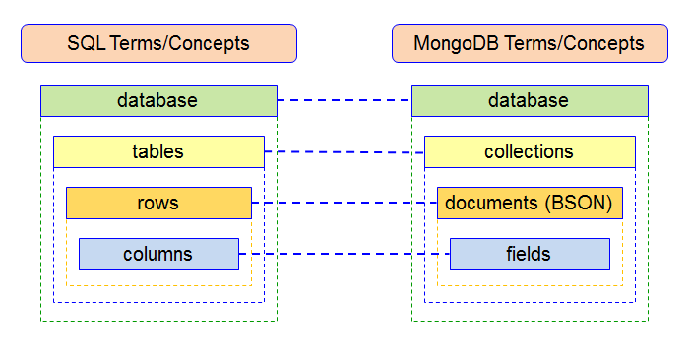
RDBMS vs MongoDB
Fig. Terminologies used in MongoDB

Slide 24
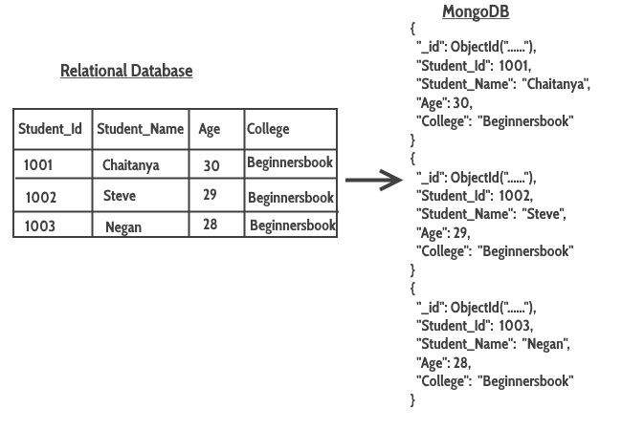
Contd….
Fig. Data Table Structure for RDBMS and MongoDB

Slide 25
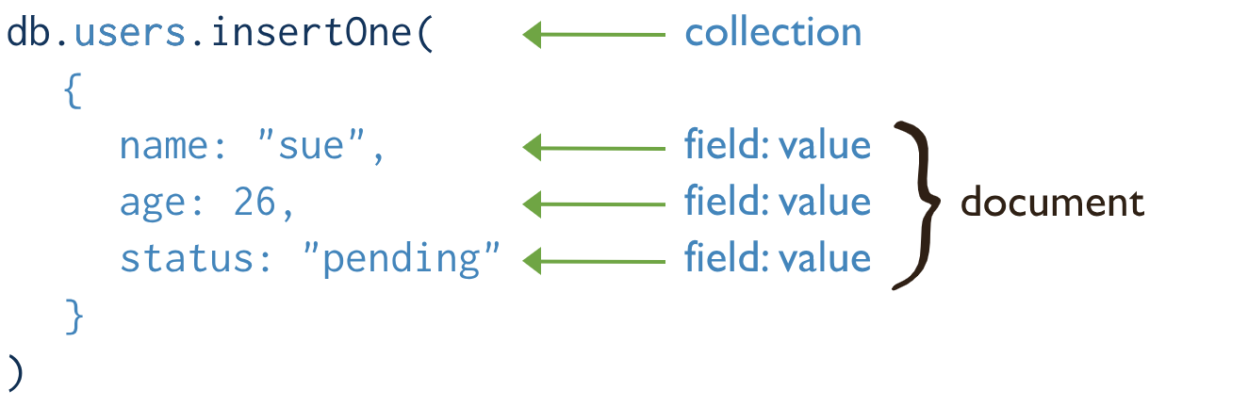
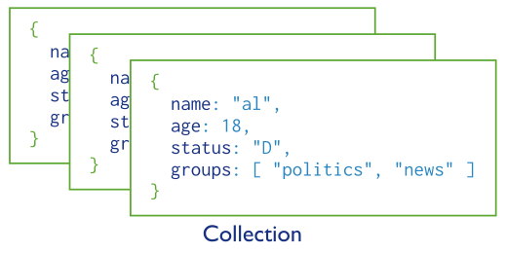
Contd…

Slide 26
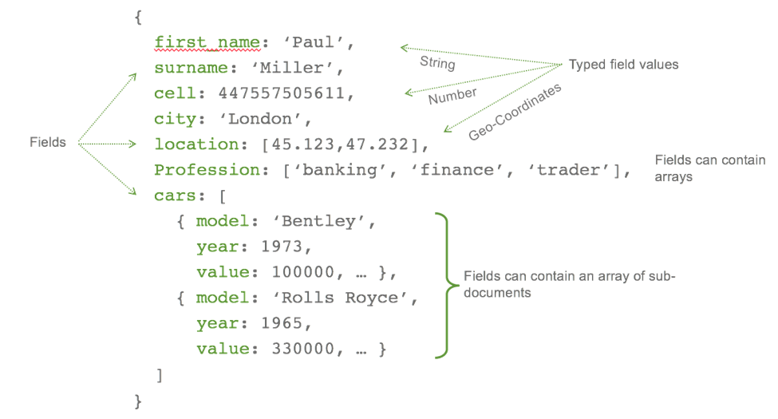
MongoDB Collection

Slide 27
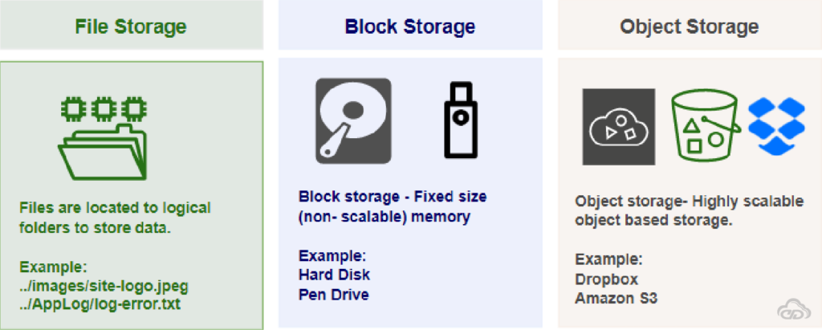
Types of Cloud Storage
Fig. Types of Cloud Storage

Slide 28
AWS S3
S3 stands for Simple Storage Service
S3 was one of the first AWS services to be developed.
It’s essentially AWS’s default storage option.
It’s quick, cheap and can hold a LOT of data.
In fact, there is no limit to the amount of storage space available. Objects (files) of up to 5 TB in size can also be stored!

Slide 29
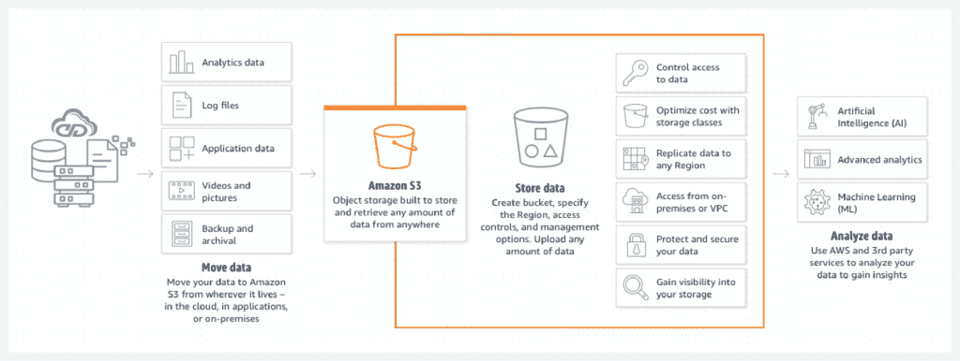
Contd…
Fig. Set of features on S3

Slide 30
AWS S3 Uses
Data Storage
Backup and Recovery
Hosting static websites
Data Archiving
Big Data Analytics

Slide 31
AWS S3 Components
Buckets and Objects
Versioning and Access Control
Bucket policies and Life Cycles
Keys and Null Objects

Slide 32
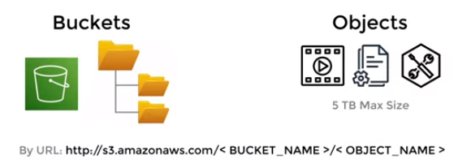
AWS S3 Bucket and Objects
Amazon S3 bucket is a fundamental Storage Container
It provides a secure and scalable repository for storing of Objects such as Text data, Images, Audio and Video files over AWS Cloud.
Each S3 bucket name should be globally unique and should be configured with ACL (Access Control List).
Maximum 100 buckets per AWS account allowed.
Key, Version ID, Value, Metadata, Sub-resources, Access control information and Tags are properties of S3 objects

Slide 33
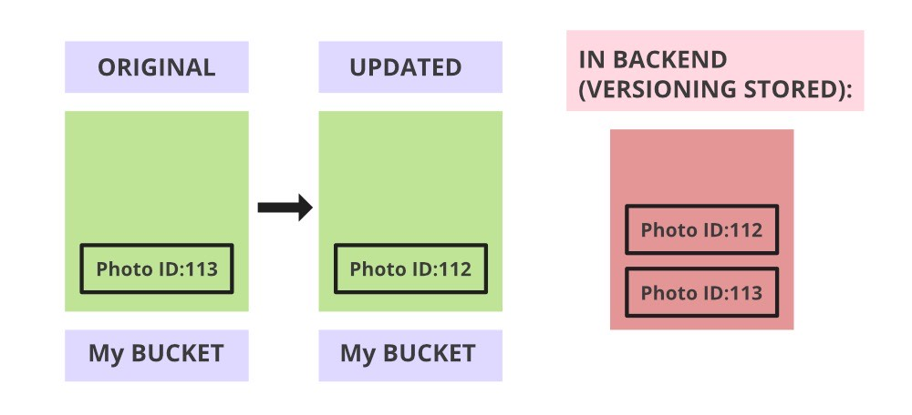
S3 Versioning
Versioning means always keep a record of previously uploaded files in S3.
Versioning is not enabled by default.
Once enabled, it is enabled for all objects in a bucket.
It adds extra cost for storing multiple copies of your data.
Fig. S3 Versioning within same bucket

Slide 34
Access Control List
A document for verifying access to S3 buckets from outside your AWS account.
An ACL is specific to each bucket.
You can utilize S3 Object Ownership, an Amazon S3 bucket-level feature, to manage who owns the objects you uploaded to your bucket and to enable or disable ACLs.

Slide 35
S3 Lifecycle
To avoid extra expenses and to maintain data as per requirement only life cycle management is needed.
There are 2 types of actions:
Transition actions
Moving objects from one storage class to another storage class.
Each storage class has a different cost associated with it.
Expiration actions
When objects expire after a span of time (say 30 days,60 days, etc).
Amazon S3 deletes expired objects on your behalf.

Slide 36
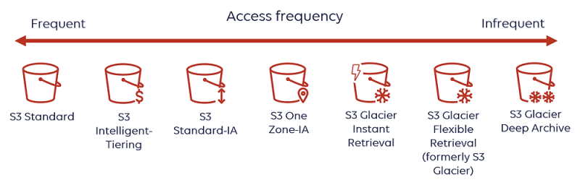
Contd….
Fig. S3 Lifecycle Management

Slide 37
Contd….
 | S3 Standard | S3 Standard IA | S3 One Zone-IA | S3 Glacier
Durability | 99.99% | 99.99% | 99.99% | 99.99%
Availability | 99.99% | 99.9% | 99.5% | NA
Availability zones | 99.9% | 99% | 99% | NA
Minimum capacity charge per object | >=3 | >=3 | 1 | >=3
Minimum storage duration charge | NA | 128 KB | 128 KB | 40 KB
Retrieval fee | NA | 30 days | 30 days | 90 days
First byte latency | Milliseconds | milliseconds | milliseconds | Minutes or hours
Storage Type | Object | Object | Object | Object
Lifecycle Transitions | Yes | Yes | Yes | Yes

Slide 38
Keys and NULL Objects
The key in S3 is a unique identifier for an object in a bucket.
For example in a bucket ‘CCBD’→demo.c file is stored at CCBD/demo.c then ‘CCBD/demo.c’ is object key for demo.c
Null Object: Version ID for objects in a bucket where versioning is suspended is null. Such objects may be referred to as null objects list.

Slide 39
AWS S3 Features
Durability
Availability
Server-Side-Encryption (SSE)
SSE-S3: AWS S3 manages encryption keys.
SSE-C: The customer manages encryption keys.
SSE-KMS: The AWS Key Management Service (KMS) manages the encryption keys.
Infinite Storage Space
File Size Support
Pay as you use

Slide 40
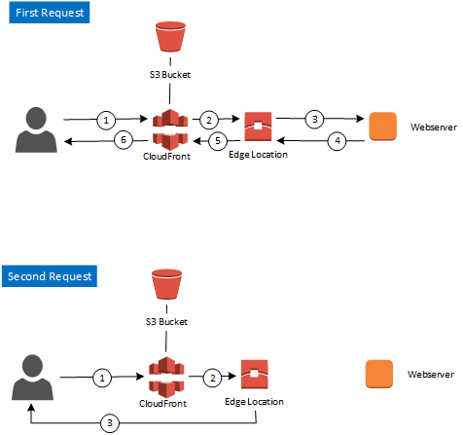
CloudFront CDN
Fig. CloudFront Computer Delivery Network

